Slide 1



Facebook Splash
Android study

Slide 2

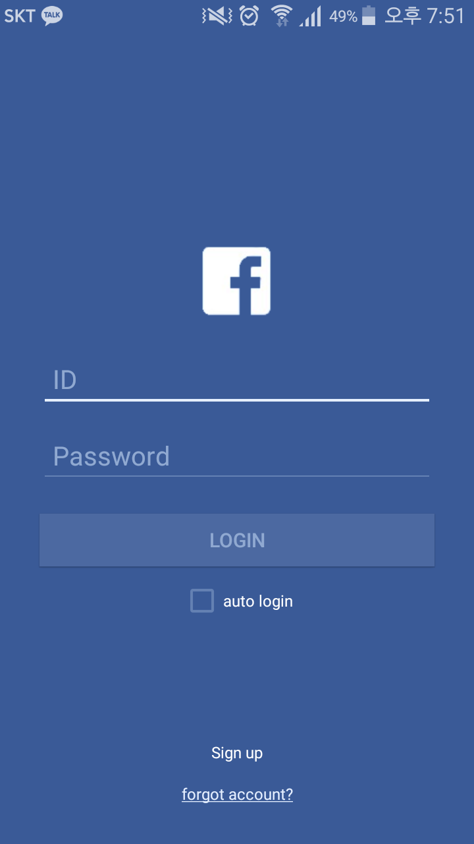
Goal 1
After 1300ms

Slide 3
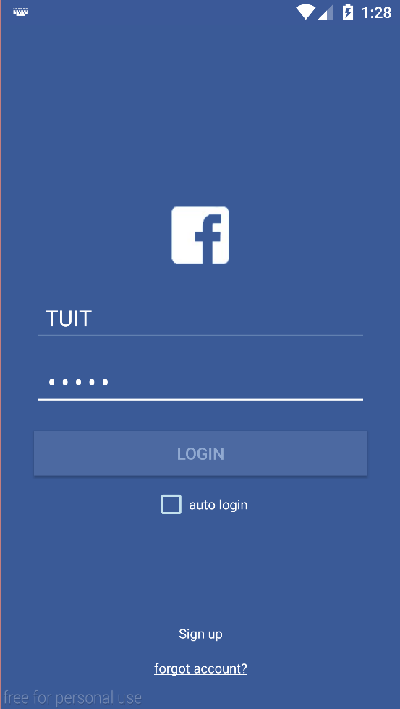

Goal 2
Send information
between Activity

Slide 4
Intent

Slide 5

Kind of message object.
Explicit Intent
Implicit Intent

Slide 6
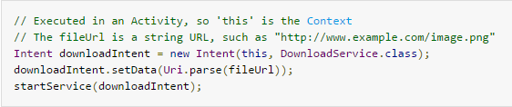
Explicit Intent

Slide 7
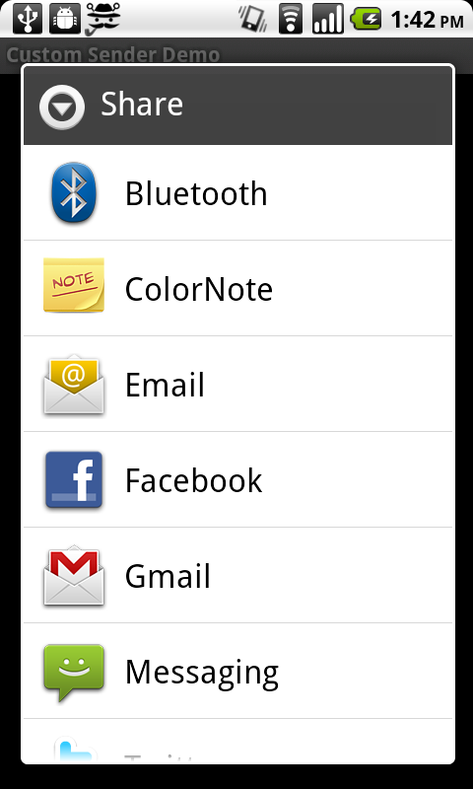
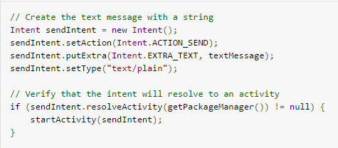
Implicit Intent

Slide 8
Thread

Slide 9
A Little about Thread
Process
vs
Thread
An instance of a computer program that is being executed
A thread is a lightweight process which exists within a program and is executed to perform a special task.
Several threads of execution may be associated with a single process.

Slide 10
A Little about Thread
one Process, many Threads
One
Process
Thread1
Thread2
Thread3

Slide 11
A Little about Thread
Even though it appears to us that many programs run at the same time, in reality, only one process is able to use a CPU core at a time.
So Threads run in one process at same time !

Slide 12
Thread in Android
Main Thread
vs
Sub Thread
Can Control UI.
Made by us.
Cannot Control UI.

Slide 13
Handler

Slide 14
Handler
Main Thread
Handler
Sub Thread

Slide 15
Method of Handler class
postDelayed(Runnable r, long delayMillis)
post(Runnable r)
sendMessageDelayed(Message msg, long delayMillis)
sendMessageAtTime(Message msg, long uptimeMillis)

Slide 16
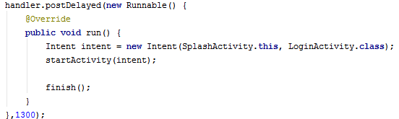
postDelayed
(Runnable r, long delayMillis)

Slide 17
Abstract method

Slide 18
public abstract void setValue(int value);
An abstract method has no body and must be overridden in a subclass.
expects to be overridden in a subclass.
in subcalss,
@Override
public void setValue(int value){ … }

Slide 19
interface

Slide 20
public abstract void setValue(int value);
An interface is similar to an abstract class that has all abstract methods.
Only one class can be extended in Java but many interface can be implemented .
public interface InterfaceName
{
(Method headers...)
}

Slide 21
Runnable interface

Slide 22
Method of runnable interface
run() //abstract void
The Runnable interface should be implemented by any class whose instances are intended to be executed by a thread. The class must define a method of no arguments called run.

Slide 23
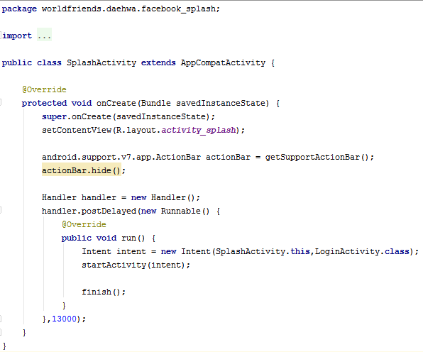
Whole Code

Slide 24
Whole Code
We can remove this line if you use parent class as Activity

Slide 25
Do you remember?
Please recall this file!

Slide 26
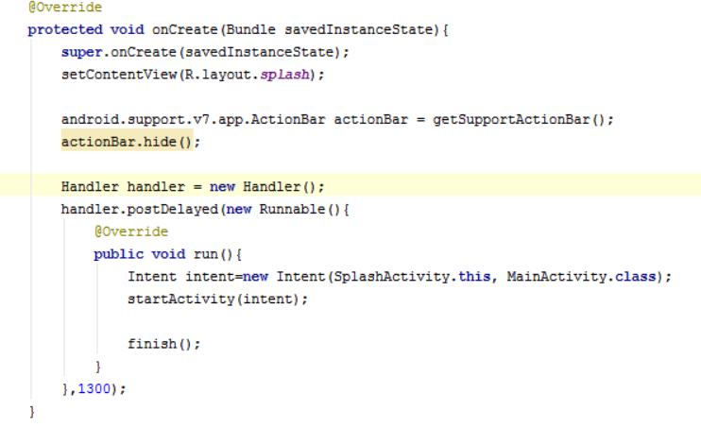

2. Parent class has method ‘getSupportActionBar()’ : get address of action bar of present activity
1. Make object of android.support.v7.app.ActionBar class
3. ActionBar class has () method ‘hide’

Slide 27
Recall: All objects are like pointer in Java.
Handler handler; is not allocated memory like a pointer. so should be written as Handler handler=new Handler();
Handler has method ‘postDelayed’. It has two parameters : runnable object and delayTime.

Slide 28
The method run in Runnable interface should be overridden.

Slide 29
Constructor of Intent Class need two arguments in this case: Intent(Context packageContext, Class<?> cls)

Slide 30
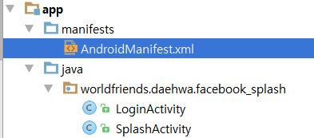
We should tell Manifest that we made new Activity

Slide 31
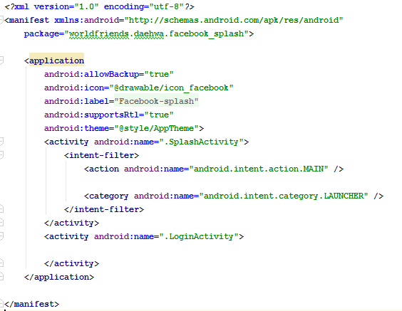

Slide 32
To use Explicit Intent

Slide 33
Method of Intent
putExtra(String name, String value)
putExtra(String name, String[] value)
putExtra(String name, boolean value)
putExtra(String name, int value)
getExtra()
getStringExtra(String name) getIntExtra(String name, int defaultValue)
getClipData()

Slide 34
putExtra
(String name, String value)

Slide 35
getExtra()
getStringExtra(String name)

Slide 36
To use Implicit Intent

Slide 37
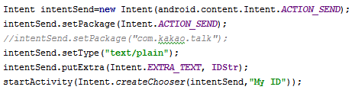
To make Intent for sending

Slide 38
Set an explicit application package name that limits the components this Intent will resolve to.

Slide 39
Set an explicit MIME data type.

Slide 40
Convenience function for creating a ACTION_CHOOSER Intent.

Slide 41

Download skeleton
https://github.com/daehwa/world-friends-Uzbekistan-android/

